Slide 1
Intrusion Detection, Snort, and Network Security Monitoring
Network Security Day 2

Slide 2
Class Objectives
By the end of class, you will be able to:
Interpret and define Snort rules and alerts.
Explain how intrusion detection systems work and how they differ from firewalls.
Explain how intrusion detection systems work and how they differ from firewalls.
Collect and analyze indicators of attack and indicators of compromise using NSM tools.
Apply knowledge of NSM, Snort rules, and Security Onion to establish situational awareness within a network.

Slide 3

Before we get started, we need to launch an instance of Security Onion.
This will generate alert data that we’ll use to complete the labs.
‹#›
Notes:
Image source: shutterstock_1083618569

Slide 4
Activity: Security Onion Setup
Follow along as we set up Security
Onion to generate alert data.
10 Minutes
‹#›

Slide 5


Recap
Firewalls protect networks by using rules to make decisions. Firewalls are designed to allow traffic from trusted sources and block traffic from untrusted sources.
Firewalls do have limitations. They can be easily fooled through packet manipulation by clever hackers.
For example, attackers can send malicious data through a firewall by hijacking or impersonating a trusted machine.
This is why it's crucial to have an effective defense in depth methodology to help protect sensitive data.
‹#›
Notes:
shutterstock_792833623

Slide 6

An intrusion detection system (IDS) both analyzes traffic and looks for malicious signatures.
‹#›

Slide 7
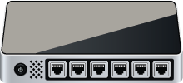




Overview: Intrusion Detection Systems
An IDS is like a firewall that reads the data in the packets it inspects, issues alerts, and blocks malicious traffic (if configured to do so).
IDS
LAN
Host 1
Internet
Host 2
Switch
Router
‹#›
Notes:
LAN and Laptops: AdobeStock_41735567 Router: shutterstock_263070023 Firewall: shutterstock_1214853796 Cloud: AdobeStock_184417876

Slide 8

Overview: IDS and NSM
There are many varieties of intrusion detection systems, but today’s class will focus on Snort, the world’s most popular open-source solution.
Network security monitoring (NSM) is the process of identifying weaknesses in a network’s defense.
It also provides organizations with situational awareness of their network.
‹#›

Slide 9


Overview: Security Onion
Security Onion is a Linux distribution that contains many NSM tools.
Security Onion uses the Snort IDS engine as its event-driven mechanism.
‹#›
Notes:
shutterstock_723768979

Slide 10
Introduction to Intrusion Detection and Snort

Slide 11

Intrusion Detection Systems
Unlike firewalls, an IDS detects and alerts of an attack.
IDS are passive. They do not respond to attacks, they only log and document information for future analysis.
IDS helps organizations establish situational awareness of attackers, allowing them to harden defenses.
‹#›
Notes:
shutterstock_792833623

Slide 12
IDS Types
There are two types of IDS:
01
Signature-based IDS
02
Anomaly-based IDS
A signature-based IDS compares patterns of
traffic to predefined signatures.
Good for identifying well-known attacks.
Can be updated as new attack signatures are released.
Vulnerable to attacks through packet manipulation.
Unable to detect zero-day attacks.
An anomaly-based IDS compares patterns of traffic against a well-known baseline.
Good for detecting suspicious traffic that deviates from well-known baselines.
Excellent at detecting when attackers probe and sweep a network.
Prone to false alerts.
Assumes network behavior does not deviate from well-known baselines.
‹#›

Slide 13
Intrusion Detection Architecture
IDS Types
Intrusion detection systems have two basic architectures:
NIDS
HIDS
Network intrusion detection (NIDS) filters an entire subnet on a network.
Host-based intrusion detection (HIDS) runs locally on a host-based system or user’s workstation or server.
‹#›

Slide 14


Intrusion Detection Architecture
Network intrusion detection (NIDS) filters an entire subnet on a network.
Internet
Matches all traffic to a known library of attack signatures.
Passively examines network traffic at points that it's deployed.
Relatively easy to deploy and difficult to detect by attackers.
NIDS
Packet Sniffer
‹#›
Notes:
AdobeStock_184417876_cloud; Magnifying Glass: FlatIcon.com; Laptops: AdobeStock_41735567

Slide 15

Intrusion Detection Architecture
Host-based intrusion detection (HIDS) runs locally on a host based system or user’s workstation or server.
Internet
Acts as a second line of defense against malicious traffic that successfully gets past a NIDS.
Examines entire file systems on a host, compares them to previous snapshots or baselines, and generates an alert if there are significant differences between the two.
HIDS
HIDS
HIDS
LOG
LOG
LOG
Centralized Control Model
‹#›
Notes:
AdobeStock_184417876_cloud; Magnifying Glass: FlatIcon.com; shutterstock_295715540; Laptops: AdobeStock_41735567; Paper shutterstock_295715540

Slide 16
Intrusion Prevention System

Slide 17
An Intrusion Prevention System (IPS) can do everything an IDS can, but can also respond to attacks.
IPS can react to packets by blocking malicious traffic, preventing it from being delivered to a host on the network.
‹#›
Notes:
Image source: shutterstock_1083618569

Slide 18

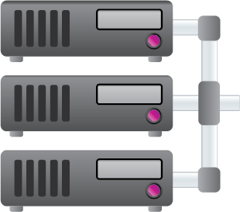



IDS vs. IPS
Intrusion Detection System (IDS)
IDS connects via a network tap or mirrored SPAN port.
Internet
Network TAP (Test Access Port) is a hardware device that provides access to a network. Network taps transit both inbound and outbound data streams on separate channels at the same time, so all data will arrive at the monitoring device in real time.
SPAN (Switched Port Analyzer), also known as port mirroring, sends a mirror image of all network data to another physical port, where the packets can be captured and analyzed.
IDS requires an administrator to react to an alert by examining what was flagged.
IDS
Firewall
Management System
Switch
Corporate Network
Notes:
Cyber thief: shutterstock_670229866_modified; shutterstock_95641768; Cloud AdobeStock_176523218; management system AdobeStock_167229043

Slide 19
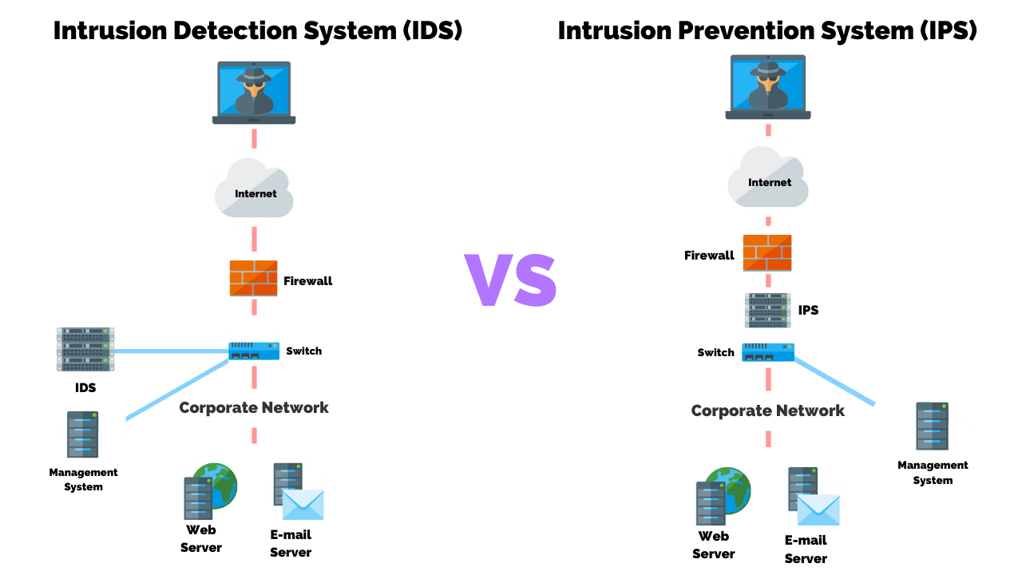
IDS vs. IPS
Intrusion Prevention System (IPS)
IPS connects inline with the flow of data, typically between the firewall and network switch.
Internet
Firewall
Requires more robust hardware due to the amount of traffic flowing through it.
IPS will automatically take action by blocking and logging a threat, thus it doesn’t require administrative intervention.
IPS
Management System
Switch
Corporate Network
Notes:
Cyber thief: shutterstock_670229866_modified; shutterstock_95641768; Cloud AdobeStock_176523218; management system AdobeStock_167229043

Slide 20
IDS Alerts
An alert is a message that is sent to an analyst’s console as an indicator of attack (IOA). An IDS system generates alerts when a Snort rule detects malicious traffic that matches a signature.
alert ip any any -> any any {msg: "IP Packet Detected";}
‹#›

Slide 21
IDS Alerts
Indicators can be either:
01
Indicator of Attack (IOA)
02
Indicator of Compromise (IOC)
Indicators of attack indicate attacks happening in real time.
Proactive approach to intrusion attempts.
Indicate that an attack is currently in progress but a full breach has not been determined.
Focus on revealing the intent and end goal of an attacker, regardless of the exploit or malware used in the attack.
Indicators of compromise indicate previous malicious activity.
Indicate that an attack has occurred, resulting in a breach.
Used to establish an adversary’s techniques, tactics, and procedures (TTPs).
Expose all the vulnerabilities used in an attack, giving network defenders the opportunity to revamp their defense as part of their mitigation strategy.
‹#›

Slide 22
Snort
There are many varieties of intrusion detection systems, but today’s class will focus on Snort, the world’s most popular open-source solution.
Network security monitoring (NSM) is the process of identifying weaknesses in a network’s defense.
It also provides organizations with situational awareness of their network.
‹#›

Slide 23
Snort is a free, open source network IDS/IPS.
‹#›
‹#›

Slide 24
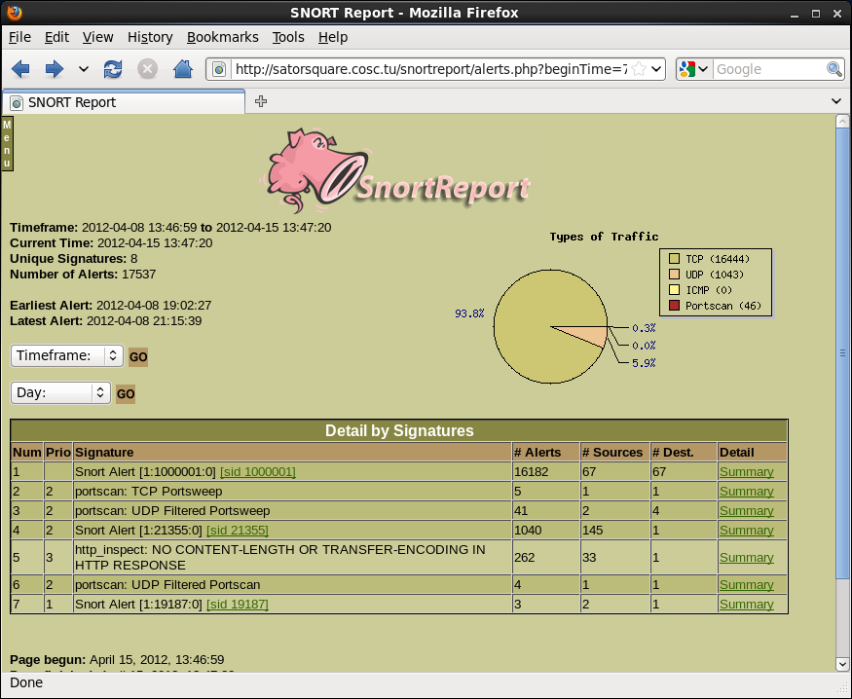
Snort
Snort is a free, open source network IDS/IPS. It can perform real-time traffic analysis and can log packets on a network.
Snort adds additional layers of defense that can be applied at various layers of the defense in depth model, including:
Perimeter IDS and IPS architecture
Network IDS and IPS architecture
Host IDS and IPS architecture
‹#›

Slide 25
Snort Configuration Modes
Snort can operate in three modes:
01
02
03
Sniffer Mode
Reads network packets and displays them on screen.
Packet Logger Mode
Performs packet captures by logging all traffic to disk.
Network IDS Mode
Monitors network traffic, analyzes it, and performs specific actions based on administratively defined rules.
‹#›

Slide 26

Snort Rules
Snort uses rules to detect and prevent intrusions. It operates by:
01
Reading a configuration file.
02
Loading the rules and plugins.
03
Capturing packets and monitoring traffic for patterns specified in rules.
04
When traffic matches a rule pattern, generating an alert and logging the matching packet for later inspection.
‹#›
Notes:
shutterstock_561749497

Slide 27
Snort Rules
Rules can direct Snort to monitor the following information:
01
02
03
OSI Layer
We can watch for IP and TCP data.
Source and Destination Address
Where the traffic is flowing from and to.
Byte Sequences
Patterns contained in data packets that might indicate malware, etc.
‹#›

Slide 28
Snort Rules
alert ip any any -> any any {msg: "IP Packet Detected";}
This rule logs the message “IP Packet Detected” when it detects an IP packet.

Slide 29
Snort Rules
Rule Header
Rule Option
any
Applies to packets coming from any source IP address.
alert
Action Snort will take when triggered.
10.199.12.8
The destination IP address.
alert tcp any any -> 10.199.12.8 21 {msg: "TCP Packet Detected";}
tcp
Applies rule to all TCP packets.
any
Applies the rule to packets from any port.
21
Applies the rule to traffic to destination port 21.
{msg: "TCP Packet Detected";}
The message printed with the alert.

Slide 30
Activity: IDS and Snort
Today, you will play the role of an SOC analyst for the California Department of Motor Vehicles (DMV).
In this activity, you will strengthen your knowledge of concepts related to Snort and intrusion detection systems.
10 Minutes
‹#›

Slide 31
‹#›

Slide 32
Networking Security Monitoring and Security Onion
‹#›

Slide 33

Network Security Monitoring Case Study
On November 24, 2014, a hacker group released confidential information from Sony Pictures that contained personally identifiable information (PII) for all employees, including full names, home addresses, social security numbers, and financial information.
It was discovered that assailants had lurked on Sony’s network for 17 months.
A number of executives and upper management were fired.
PII of all employees was exposed.
Sony suffered massive damage to its reputation.
Sony had to pay massive fines for violating federal regulations.
(thenextweb.com)
‹#›

Slide 34
If Sony had a strong network security monitoring program, they would have discovered the attack much sooner—perhaps within hours—stopped it, and gotten a better understanding of the TTPs of the attacker.
‹#›
Notes:
Image source: shutterstock_1083618569

Slide 35

Network Security Monitoring
Network security monitoring use a variety of data analysis tools to detect and stop threats after most front-end layers are compromised.
(Source)
‹#›
Notes:
https://dribbble.com/shots/4480339-Safe-servers-on-the-blockchain

Slide 36

NSM Strengths
NSM allows organizations to:
Track adversaries through a network and determine intent.
Acquire intelligence and situational awareness.
Be proactive by identifying vulnerabilities.
Be reactive through incident response and network forensics.
Provide insights about advanced persistent threats.
Uncover and track malware.
‹#›

Slide 37
NSM Weaknesses
NSM has its limitations:
Cannot read encrypted traffic.
Powerful hardware and CPU requirements mean higher costs.
Difficulty reading radio transmissions, meaning attackers can use mobile radio communications to obfuscate attacks.
NSM is an invasive process that monitors and records all network data.
Placement of an NSM can be limited at certain areas of the network.

Slide 38
NSM Stages and Processes
NSM operates in two stages, each involving two processes:
01
Detection
02
Response
An alert is generated in the Sguil analyst console.
A security team responds to a security incident.

Slide 39
NSM Stages and Processes
Detection
An alert is generated in the Sguil analyst console.
Collection The event is observed and the data is stored in the form of a PCAP file.
Analysis The alert data is identified, validated, documented, and categorized according to its threat level.
Host data
IOC-centric analysis, or “matching”
Net data
Analyst console(s)
Application logs
Data from third party
IOC-free analysis, or “hunting”
Data from constituent
Event observed/stored
Identification
Validation
Document
Request more data
‹#›

Slide 40

NSM Stages and Processes
Response
A security team responds to a security incident.
Escalation All relevant parties are notified about the security incident.
Resolution The process of containment, remediation, and any additional necessary response.
Constituent notification
Constituent response
Analyst console(s)
New IOC creation
Constituent portal
Additional response
New collection requirement
Collection improvement
New analysis requirement
Analysis improvement
Notification
Acknowledgement
Containment
Remediation
‹#›

Slide 41
Intrusion detection systems are generally placed at strategic points in a network where traffic is most vulnerable.
These devices are typically placed next to a router or switch that filters traffic.
‹#›
Notes:
Image source: shutterstock_1083618569

Slide 42
NSM Sensor Connectivity
IDS can be physically connected to a network in two ways:
01
SPAN or Mirrored Port
02
Network TAP
A SPAN port is a function of an enterprise-level switch that allows you to mirror one or more physical switch ports to another port.
A mirror image of all data will flow across both ports equally.
The most common type of TAP is an aggregated TAP, in which a cable connects the TAP monitor port with the NIC on the sensor. This specific placement allows traffic to be monitored between the router and switch.

Slide 43




NSM Sensor Connectivity
01
SPAN or Mirrored Port A SPAN port is a function of an enterprise-level switch allowing you to mirror one or more physical switch ports to another port. A mirror image of all data flows across both ports equally. This allows the IDS to perform packet captures on all inbound and outbound traffic within a network.
24-Port Switch
Port 1
Port 2-23
Attached to Port 24
Mirrored Traffic from Port 1
Router
Network Assets
Sensor
‹#›
Notes:
shutterstock_227831053

Slide 44

NSM Sensor Connectivity
02
Network Tap The most common type of TAP is an aggregated TAP, in which a cable connects the TAP monitor port with the NIC on the sensor. This specific placement allows traffic to be monitored between the router and switch.
Tap
Router
Switch
Sensor
‹#›
Notes:
shutterstock_227831053

Slide 45
Security Onion
Today we'll work with Security Onion, a network security monitoring platform that provides context, intelligence, and situational awareness of a network.
Security Onion is an Ubuntu-based, open source Linux distribution that contains many NSM tools used to protect networks from attacks.
‹#›
Notes:
shutterstock_723768979

Slide 46

Security Onion and NSM
We’ll also use a few NSM tools for incident detection and response:
01
02
03
Sguil Pulls alert data from Snort, allowing us to more thoroughly analyze alerts.
Transcript Provides a view of PCAP transcripts that are rendered with TCP flow.
NetworkMiner Performs advanced network traffic analysis through extraction of artifacts contained in PCAP files.
‹#›

Slide 47
Sguil
Sguil has six key functions that help with analysis:
01
Performs simple aggregation of alert data records.
02
Makes available certain types of metadata.
03
Allows queries and review of alert data.
04
Allows queries and review of session data.
05
Allows easy transitions between alert or session data and full content data.
06
Counts and classifies events, enabling escalation and other incident response decisions.
‹#›

Slide 48
Sguil
Sguil has four main sections:
01
Alert Panel
02
Snort Rule
03
Packet Data
IP Resolution
04
‹#›

Slide 49
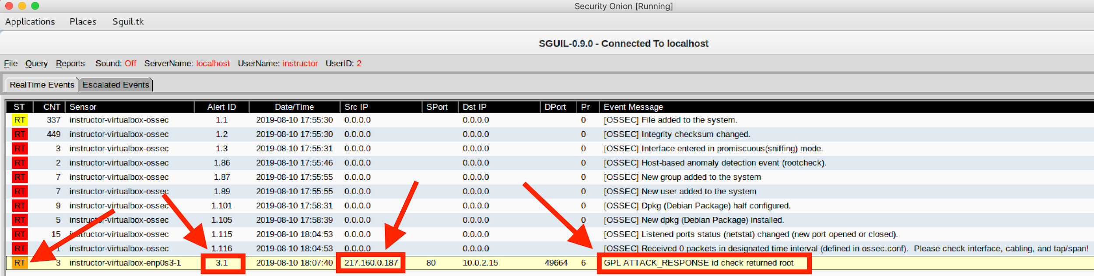
Sguil Alert Panel
ST or Status | Colors indicate severity levels of real-time"or "RT" events. Red Critical, possible data breach in progress. Must be resolved immediately. Orange Moderate, high potential for data breach. Requires immediate review. Yellow General, low potential for data breach. Requires review.
Alert ID | A randomly generated numerical ID created by Sguil.
Source IP | IP address of the source identified by the alert.
Event Message | The message generated by the Snort rule option.
‹#›

Slide 50
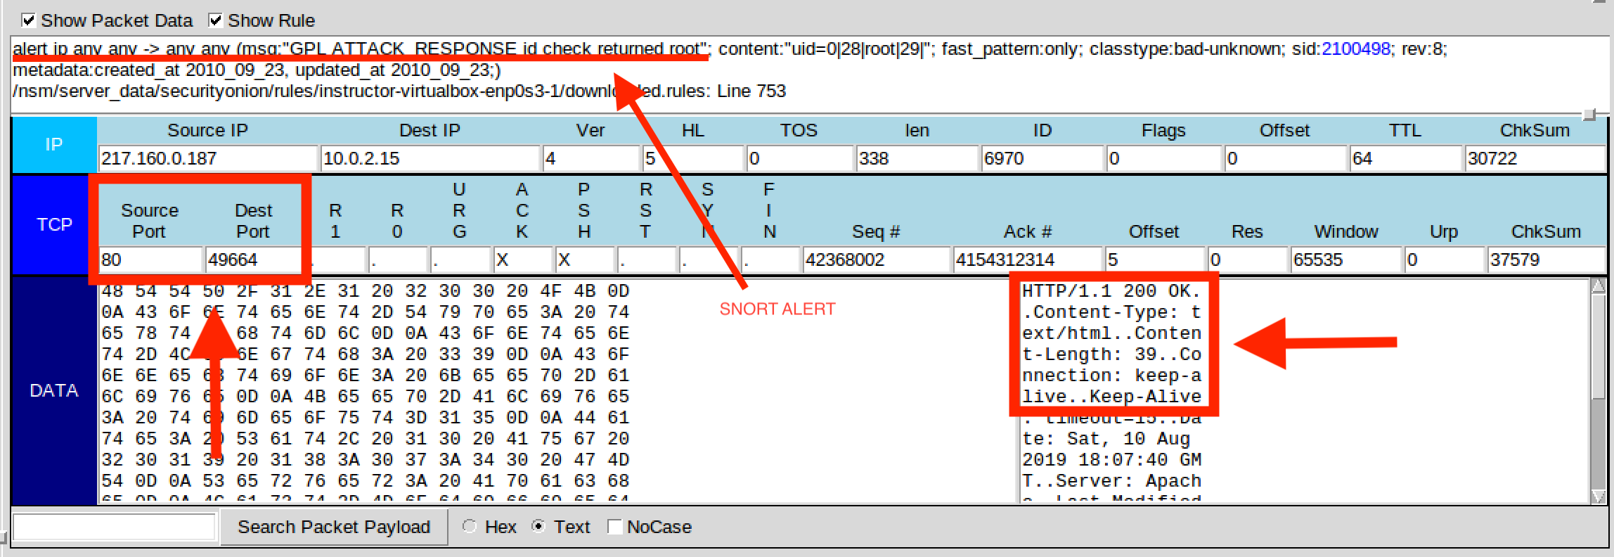
Sguil Snort Rule and Packet Data
Snort Rule | Packet Data
In the top portion of this window is the Snort NIDS engine that generated alert data when traffic matched one of its rules. Alert data is an indicator of attack. An analyst may have to determine if it represents benign or malicious activity. Alert data from the Snort NIDS stores entries in the Event Messages column that begin with text like “ET” (for Emerging Threats, an IDS rule source). | The lower, more colorful part of this window is the portion of Sguil that performs network packet analysis. The packet analyzer presents a detailed view of the data capture that includes packet header information and data streams presented in hex and text form.
‹#›

Slide 51
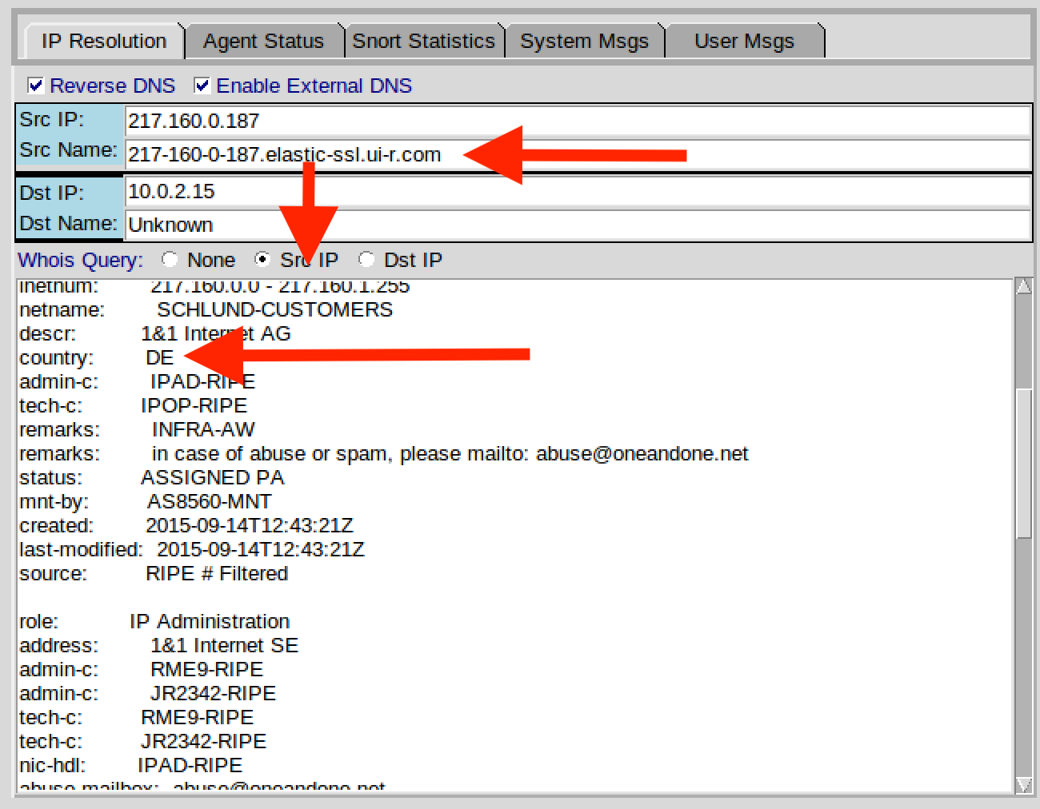
Sguil’s IP Resolution
This section of Sguil's analyst console provides reverse DNS lookup information.
This information is used to reveal identifying information about the attacker, including domain name registries and IP addresses.
Other information may include country of origin, and possibly the names, email addresses, and/or phone numbers of the DNS registrants.
‹#›

Slide 52
Activity: Security Onion and NSM
In this activity, you will reinforce your
knowledge of Security Onion and network
security monitoring.
20 Minutes
‹#›

Slide 53
‹#›

Slide 54


‹#›
Notes:
Image source: AdobeStock_56885471

Slide 55
Alert:
FTP File Extraction
‹#›

Slide 56

Security Onion Demo Setup
Sometimes, an alert requires an analyst to do some data mining.
A security analyst must have a thorough understanding of how NSM tools are integrated.
These skills help speed up incident and response efforts.
(Source)
‹#›
Notes:
https://dribbble.com/search/shots/popular/animation?q=mining

Slide 57
In the next walkthrough, we’ll use Sguil as the starting point for learning other NSM tools for security investigations.
‹#›
Notes:
Image source: shutterstock_1083618569

Slide 58
Security Onion - Sguil
‹#›

Slide 59

Security Onion and NetworkMiner Demo
Now that we now know there was a drive-by attack, we must search for any files that were downloaded to the host.
We’ll use a forensics tool called NetworkMiner to extract any files that were installed on the user’s machine, and put together an attacker profile.
Network Miner is an NSM tool that performs advanced Network Traffic Analysis (NTA) of extracted artifacts, presented through an intuitive interface.
‹#›

Slide 60
Security Onion - NetworkMiner
‹#›

Slide 61
Activity: Alert - FTP File Extraction
In this activity, you will examine an alert to determine if any systems were
breached and if any data was supplanted
or exfiltrated from the network.
20 Minutes
‹#›

Slide 62
‹#›

Slide 63
Questions?
‹#›

